Slide 1
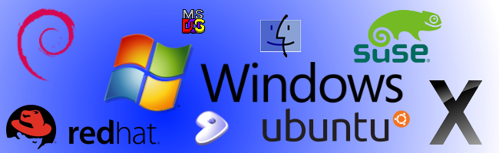

Operating Systems
Chapter 5 – Lecture 6
Dhanusha Somawardhana
BSc(Hons) IT(SLIIT), MBA (UoW), Reading DBA (Aeu)

Slide 2

Introduction
Software that enables us to operate the computer system.
What is the role of an OS? Playing Games?
Manager of system resources such as the processor, I/O devices, memory etc.
Bridge the gap between Hardware and Application Software

Slide 3
OS Facts
The very first operating system they coded was XENIX, not MS-DOS. In fact, MS-DOS was a modified license version of the 86-DOS, which was also known as Quirky and Dirty DOS, created by Seattle Computer Products in 1980.
Bill Gates coded the class scheduling program for his high school. He wrote the code in such a way that he was allotted a seat next to girl students.
Microsoft holds more than 10,000 patents and they’ve successfully made to the list of top-five patent holders in the USA. Microsoft files around 3,000 patent requests per year.
More than 90% of current Linux source code is written by other developers
Linux totally dominates supercomputers. As of 2018 100% of the world’s 500 fastest supercomputers run Linux. Impressive!
There are 20,323,379 lines of code in the Linux kernel as of 2018

Slide 4
Bootstrapping
Loads into the main memory within the process called bootstrapping
First step was to automatically load the program with least possible human involvement.
Knows as booting.

Slide 5
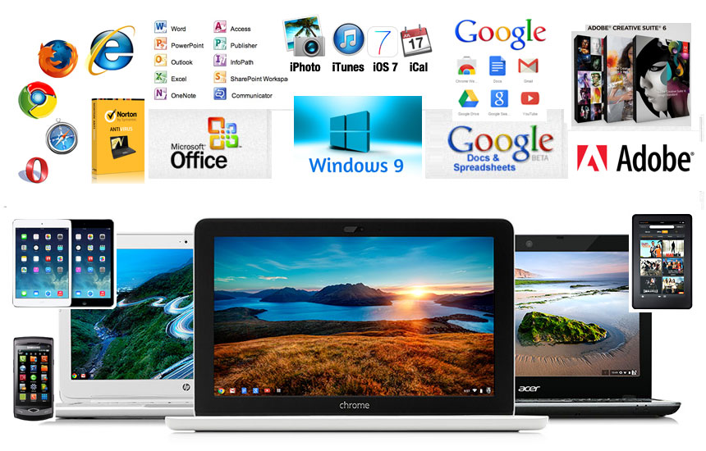
New Software and Hardware
As the hardware steadily improved, the execution time of the programs fell.
Two Consequences -
The setup time of the jobs became disproportionate to run time of the job.
The I/O devices were much slower than the processor.
Processor spent most of the time waiting for I/O jobs to be completed.

Slide 6
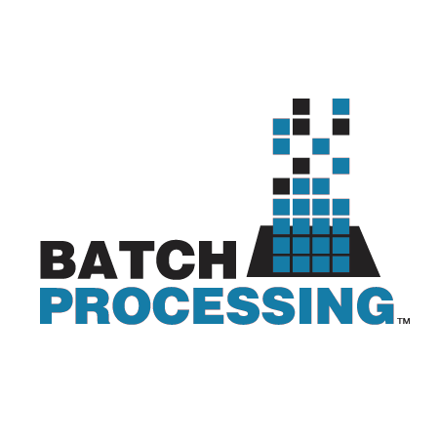
Batch Processing
Was introduced because the jobs were supplied in batches.
Supplied by a set of jobs at one time instead of a single job.
Task of doing the same job over and over again.

Slide 7
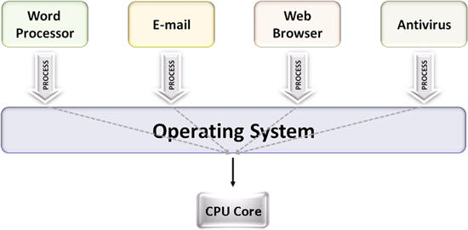
Multiprogramming
As the improvement in hardware continued, the computer became faster and faster.
Running several programs simultaneously.
In a Batch Multiprogramming System, a series of jobs were loaded into the memory.

Slide 8
Cont.
Some Systems - Foreground and Background jobs.
Foreground jobs could run whenever they could.
Background jobs could run whenever there were no foreground jobs.
Background jobs - Processor Bound and I/O Bound

Slide 9
SPOOL
SPOOL - Simultaneous Peripheral Operations On Line.
Surplus processor time is utilized in performing I/O transfers for other jobs.
Benefit - Access to slower peripherals is restricted to a single program.

Slide 10
Operating Systems: Services
Services of the OS
Information Management
Process Management
Memory Management
Disk Management

Slide 11
Types of OS
Batch Operating Systems
Multiprogramming Operating Systems
Distributed Operating Systems

Slide 12
Batch Operating System
Requires program, data and appropriate system commands to be submitted together to the computer in the form of a job.
No interaction with the users and executing programs.
Common on a mainframe computer that was purchased specifically with massive repetitive data processing in mind.
Processing mostly done in FIFO order.

Slide 13
Cont.
Activities –
Memory Management
Resource Utilization
Good for data management and Statistical analysis
Unsuitable for program development.
Ex: Batch Monitor

Slide 14
Multiprogramming Operating Systems
Multiprogramming Operating Systems - The OS which multiplexes the system resources among all its active programs.
A program in execution is called a process or task.
Can support a number of tasks by simultaneously maintaining their code and data.
Often combined with hardware and software support for memory protection to avoid erroneous processes

Slide 15
Cont.
Provide a more sophisticated form of memory management and concurrency control.
Becomes critical when the executing processes access shared I/O devices and files.
Used in computer systems with more than one processor.
Provide the general complement of other types of systems and management and scheduling of the processors.

Slide 16
Types of Multiprogramming Operating Systems
Time-sharing systems
Real-time systems
Combination operating systems

Slide 17

Time Sharing System
Multi-programmed multiuser systems.
A user has the illusion of having the machine all to himself. All the users are given a share of the common resources.
Done by using time-slicing scheduling algorithms.
The programs are executed in rotating priority mechanism.

Slide 18
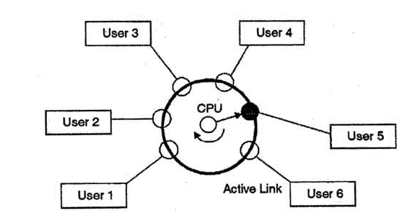
Cont.
If a program takes longer time than the slice of time allocated to it, then its execution is interrupted by the operating system.
Sophisticated I/O Management and Memory Management
Providing protection and access control to the files.

Slide 19
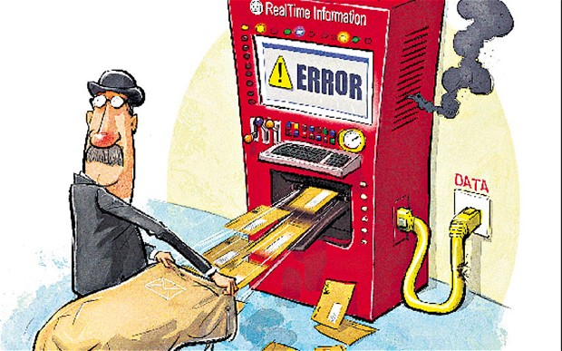
Real Time System
A real-time system can be defined as a system, which requires a very fast response.
The response of the operating system generates has a considerable amount of effect on the overall working of the system.

Slide 20
Cont.
User convenience and resource utilization are less in priority in these kinds of systems.
Can process thousands of interrupts per second.
Scheduling is done by assigning priority to the processes.
This type of scheduling is called priority-based preemptive scheduling.
Memory management in real-time systems is comparatively less demanding. - Most of the processes are made to permanently reside in the memory in order to provide a quick response.
File management is generally found in larger installations of real-time systems and basically concerned with the speed of access of files

Slide 21
Combination operating systems
An operating system may not fit exactly to the requirement of a specific environment.
Generally made to have the features of more than one type of systems

Slide 22
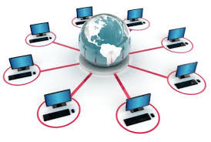
Distributed Operating Systems
Collection of a set of computers interacting and communicating with each other via their hardware, software and a set of links.
A distributed operating system governs the role of managing these kinds of systems.
The components and resources of the system are hidden from the users.
Facilitate access to remote resources, communication with remote processes and distribution of computation.

Slide 23
Thank You…!!!

